Slide 1

{7he B0tS}

Slide 2
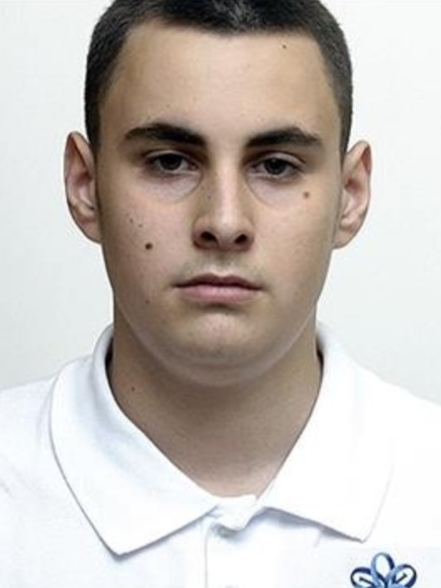
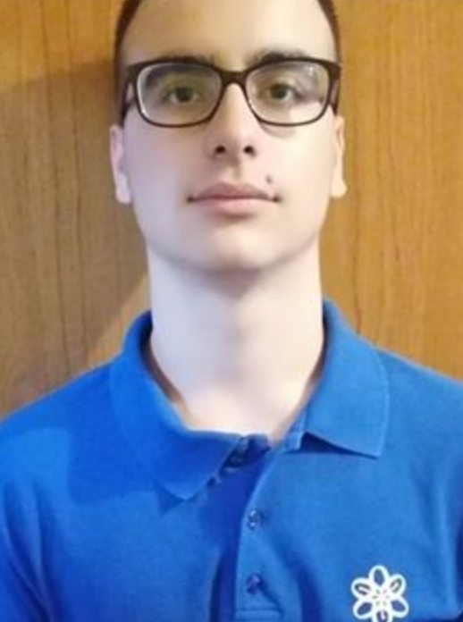
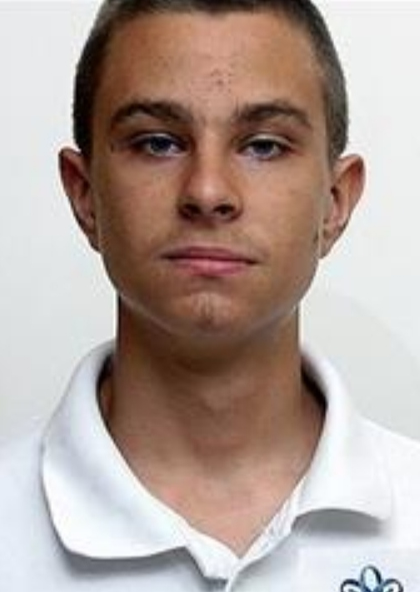
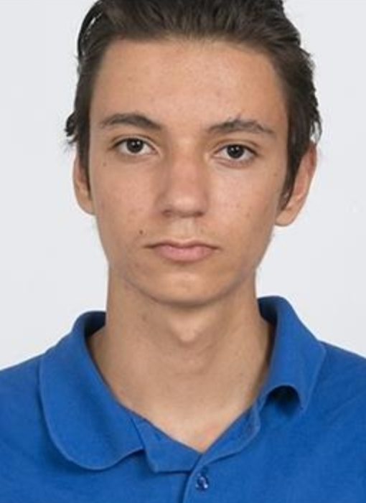

Members
Dimitar Bodurov (Scrum Trainer) DTBodurov19@codingburgas.bg
Velimir Dimitrov (Front-end Developer) VVDimitrov19@codingburgas.bg
Zahari Bonev (Back-end Developer) ZNBonev19@codingburgas.bg
Andrei Andreev (Q&A) AGAndreev19@codingburgas.bg

Slide 3






Used programs

Slide 4
Stages of realization

Slide 5

Game preview

Slide 6

Thank you for your attention

